Slide 1
Parallel Computing with GPUs
Using CUDA with Visual Studio 2022

Slide 2
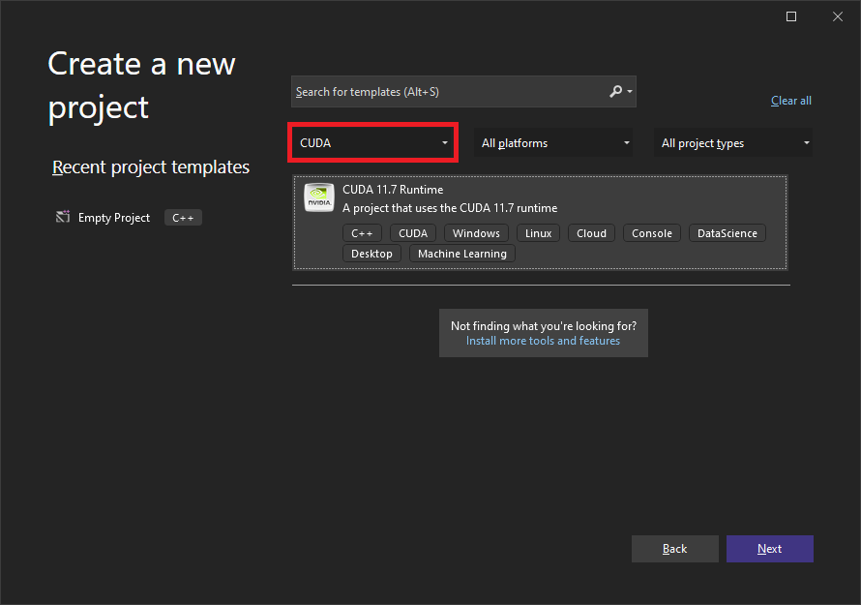
New CUDA Project
Select “CUDA” from the language drop-down.
Select “CUDA 11.7 Runtime” and follow the regular steps. This will enable additional settings required for CUDA.

Slide 3
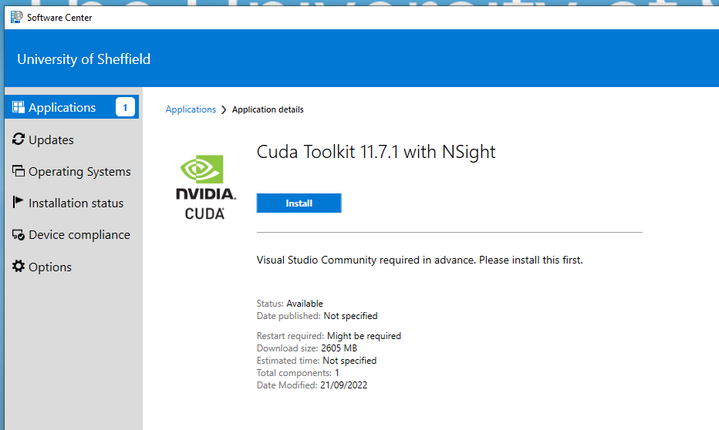

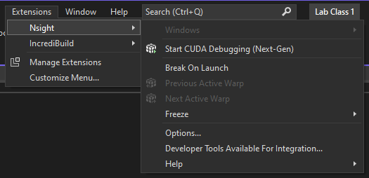
Installing CUDA
As of 2021 the following buildings have computer labs containing machines with GPUs: Heartspace, IC, Hicks, Firth Court, Elmfield.
Unlike in The Diamond, It may be necessary to install (Visual Studio and the) CUDA toolkit on these machines, via the Software Centre, on first use. This may take upto 30 minutes to complete.
Visual Studio MUST be installed before the CUDA toolkit.
When installed, Visual Studio will contain the “Extensions -> Nsight” menu.

Slide 4
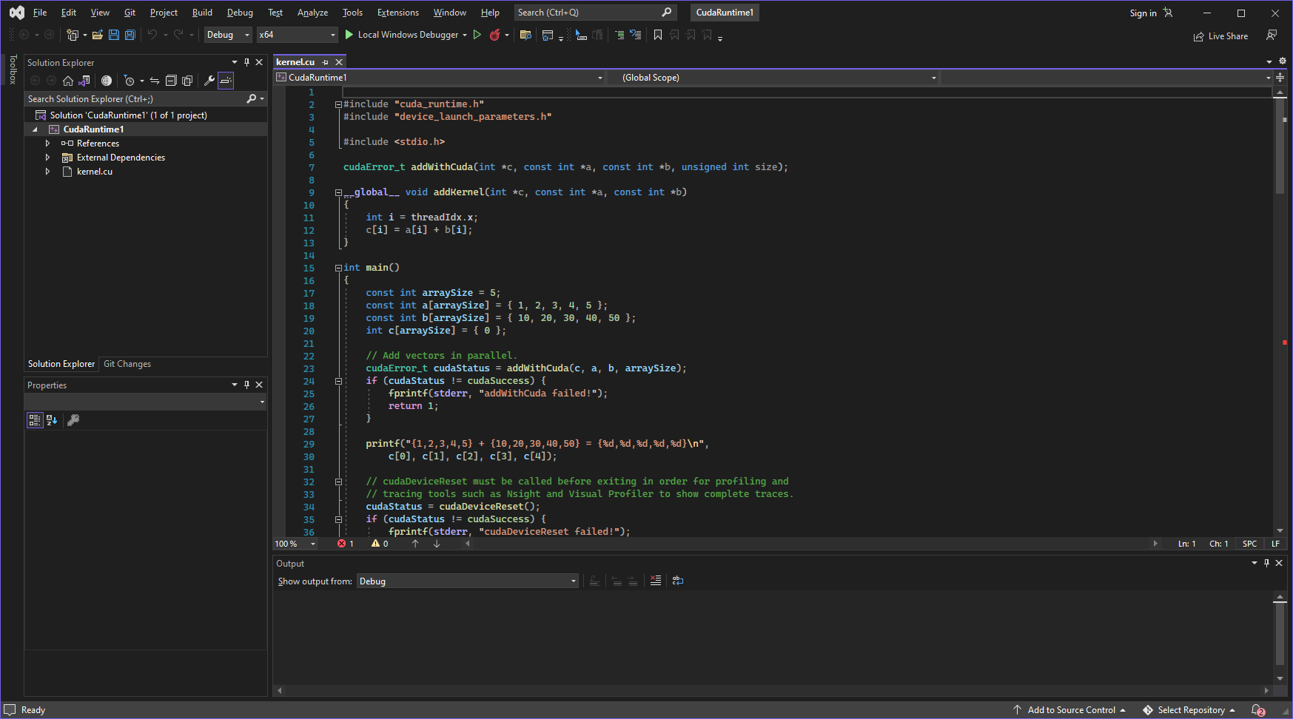
New CUDA projects begin with a sample program “kernel.cu”, this can be deleted, or emptied to use for your own code.

Slide 5
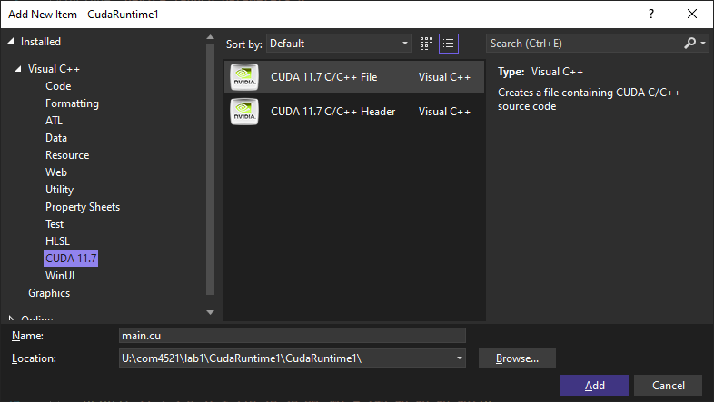
New CUDA file
Open the add new item dialog and select NVIDIA CUDA in the left menu. Select “CUDA C/C++ File”
If you instead rename a .c file to .cu it won’t be built with the CUDA compiler.
Although this can be fixed via the file’s properties

Slide 6
Device Versions
Different generations of NVIDIA hardware have different compatibility
In the last lecture we saw product families and chip variants
These are classified by CUDA compute versions
Compilation normally builds for CUDA compute version 52
See Project Properties, CUDA C/C++Device->Code Generation
Default value is “compute_52,sm_52”
Any hardware with greater than the compiled compute version can execute the code (backwards compatibility)
You can build for multiple versions using separator
E.g. “compute_35,sm_35;compute_61,sm_61”
This will increase build time and compiled binary size
Runtime will select the best version for your hardware
Full GPU to sm version map: https://developer.nvidia.com/cuda-gpus

Slide 7
Device Versions of Available GPUs
Managed desktops with GPUs (e.g Diamond Machines)
Pascal Architecture
compute_61,sm_61;
Virtual Classroom 3
Kepler Architecture (Deprecated in CUDA 11, Support Removed in CUDA 12)
compute_35,sm_35;
HPC
Sharc
Kepler Architecture
compute_35,sm_35;
Stanage (Coming soon ~April)
Ampere Architecture (A100 specific version)
compute_80,sm_80;

Slide 8
Device Versions You May Own
GTX 10 series (e.g. GTX 1080)
Pascal Architecture
compute_61,sm_61;
RTX 20 series, GTX 16 Series
Turing Architecture
compute_80,sm_80;
RTX 30 series
Ampere Architecture
compute_86,sm_86;
RTX 40 series
Ada Lovelace Architecture
compute_89,sm_89;

Slide 9
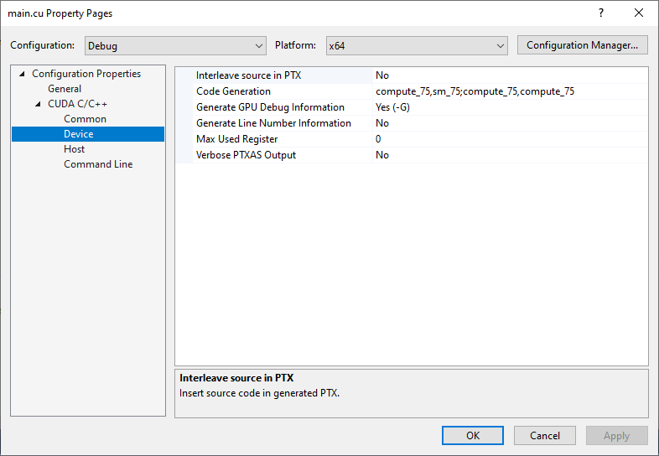
CUDA Properties

Slide 10
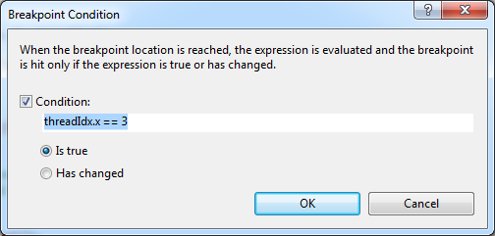

Debugging
NSIGHT is a GPU debugger for debugging GPU kernel code
It does not debug breakpoints in host code
To launch select insert a breakpoint and select NSIGHT-> Start CUDA Debugging (Next Gen)
You must be in the debug build configuration.
When stepping all warps except the debugger focus will be paused
Use conditional breakpoints to focus on specific threads
Right click on break point and select Condition

